Slide 1
Gregarious Glove
By: Akshaj Arora, Joshua Huff and Jakub Glebocki

Slide 2
INTRODUCTION and PURPOSE
We present an cost effective and easy to wear smart glove that will be used to convert sign language and display characters on LCD.
The product is capable to display the characters on the LCD as well as transfer the data through bluetooth.
The device is made to improve communication between deaf and non-deaf speakers.

Slide 3
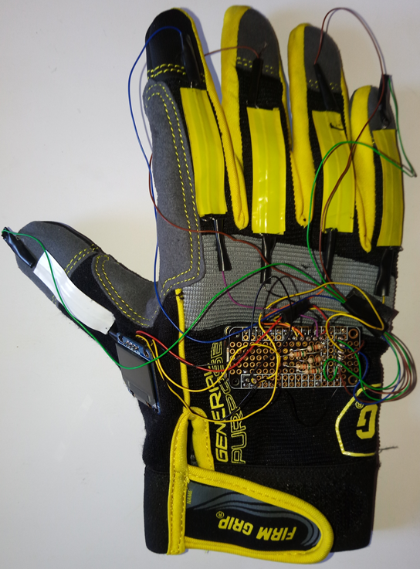
DEVICE CONSTRUCTION
Construction of bend sensors.
Velostat
Conductive Fabric
Electrical Tape
Sensors are placed on the fingers. As fingers bend, resistance of sensor changes.
Voltage dividers are used to record the relative changes in each sensor.
LCD to display the characters.

Slide 4
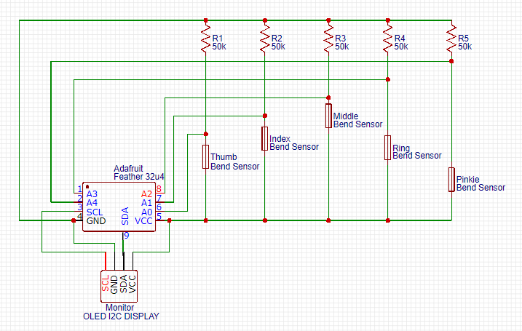
CIRCUIT DIAGRAM
Pin 5~ is the send pin
Pin A0,A1,A2,A3, A4 are the receive pin
Pin A0 = Thumb Bend Sensor
Pin A1 = Index Bend Sensor
Pin A2= Middle Bend Sensor
Pin A3 = Ring Bend Sensor
Pin A4 = Pinky Bend Sensor

Slide 5
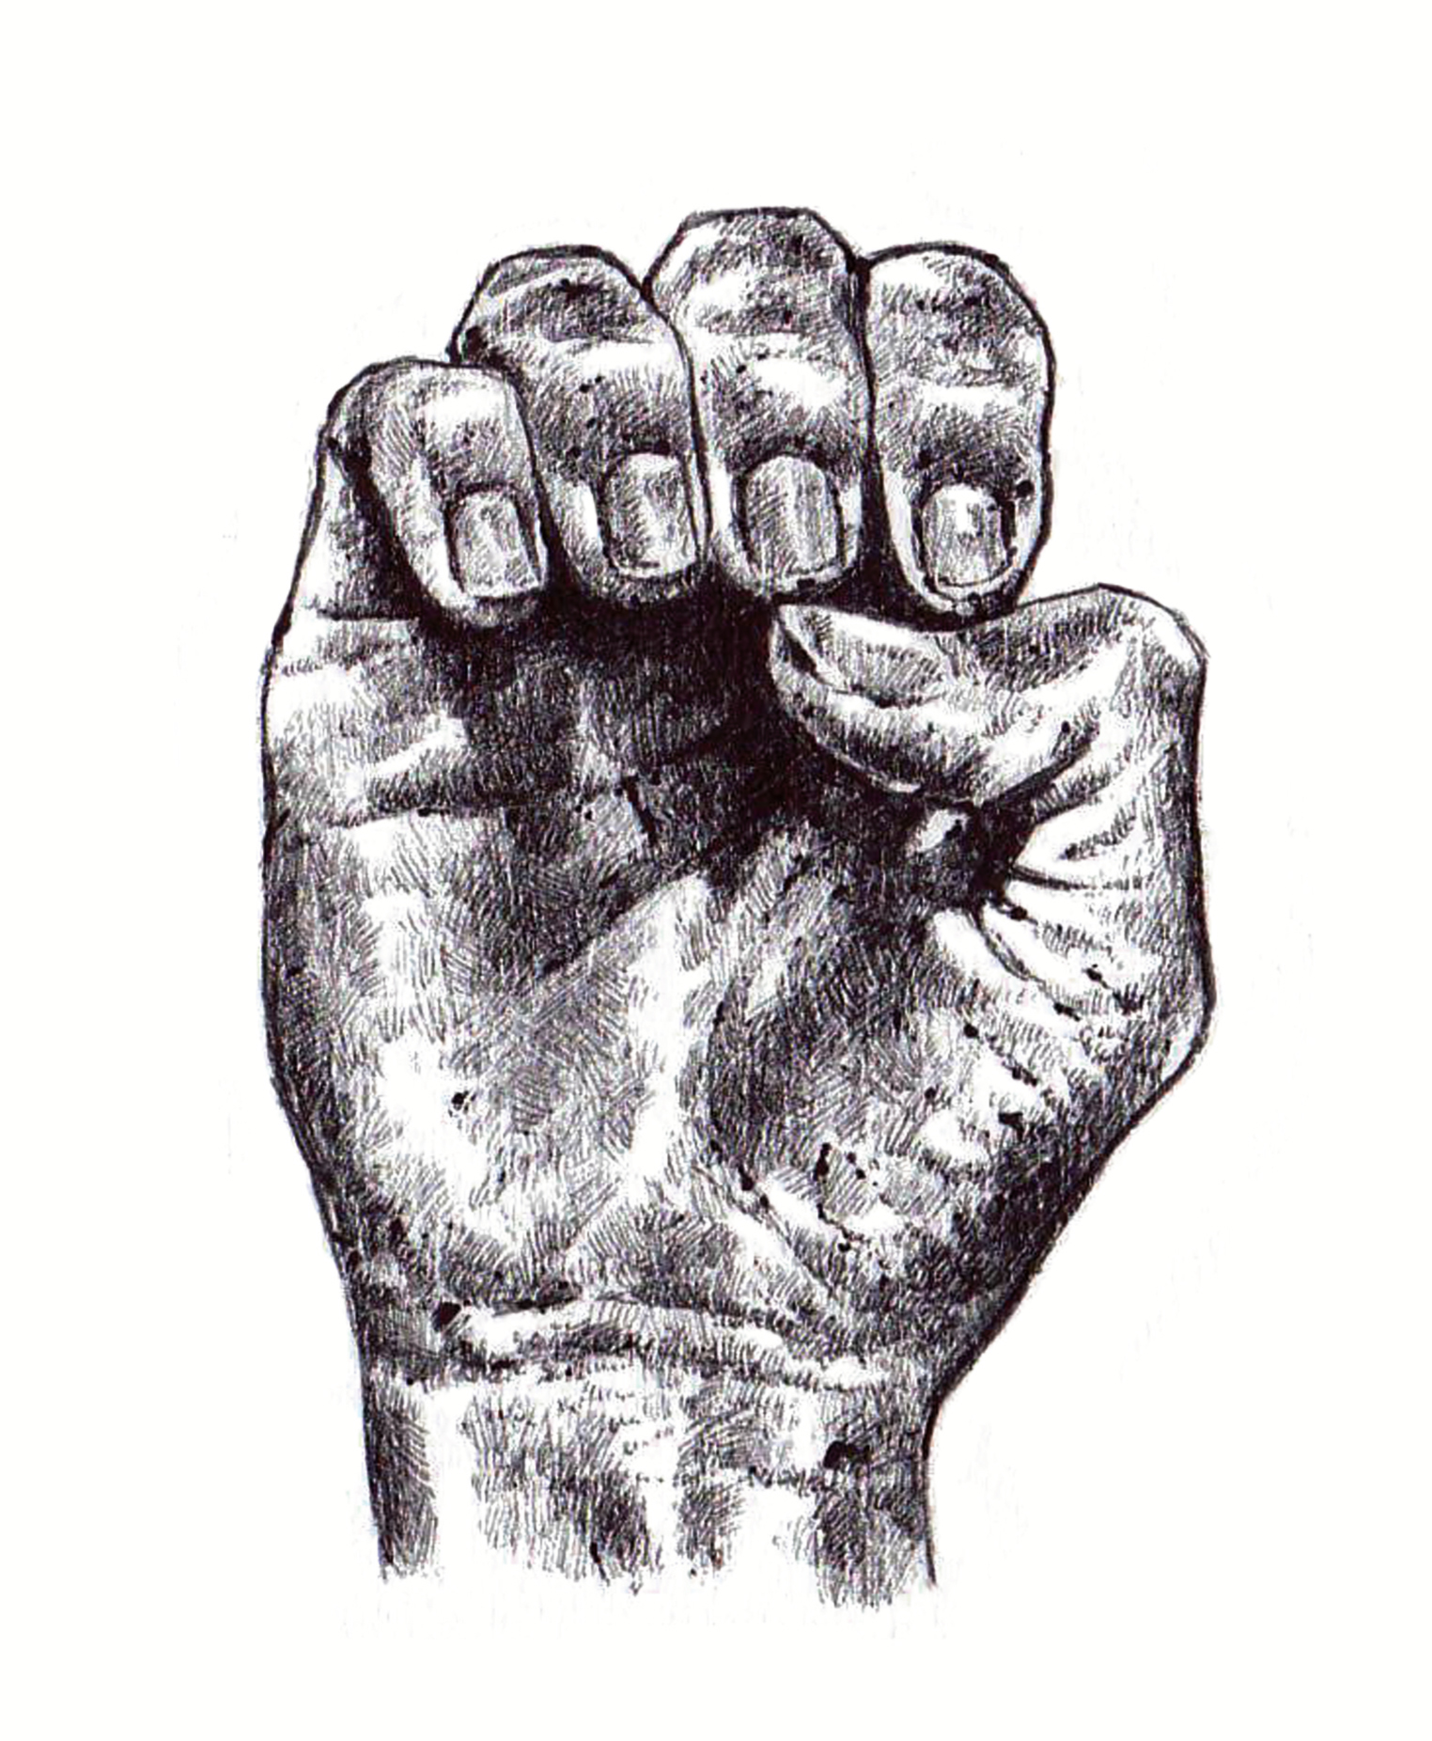
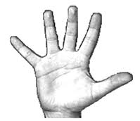
PROCESSING Calibration
Two Calibration states “E” and a “5”
These states are the best for determining the max and min values
From these value thresholds are determined
General Formula (max-min)*⅓+min and (max-min)*⅔+min

Slide 6
Processing Code Calibration
s1_0 = (max1 - min1) * 1/4 + min1; //Thumb Threshold 1 s2_0 = (max2 - min2) * 1/4 + min2; //Index Threshold 1 s3_0 = (max3 - min3) * 1/4 + min3; //Middle Threshold 1 s4_0 = (max4 - min4) * 1/4 + min4; //Ring Threshold 1 s5_0 = (max5 - min5) * 1/3 + min5; //Pinkie Threshold 1 s1_1 = (max1 - min1) * 3/4 + min1; //Thumb Threshold 2 s2_1 = (max2 - min2) * 3/4 + min2; //Index Threshold 2 s3_1 = (max3 - min3) * 2/3 + min3; //Middle Threshold 2 s4_1 = (max4 - min4) * 2/3 + min4; //Ring Threshold 2 s5_1 = (max5 - min5) * 2/3 + min5; //Pinkie Threshold 2

Slide 7
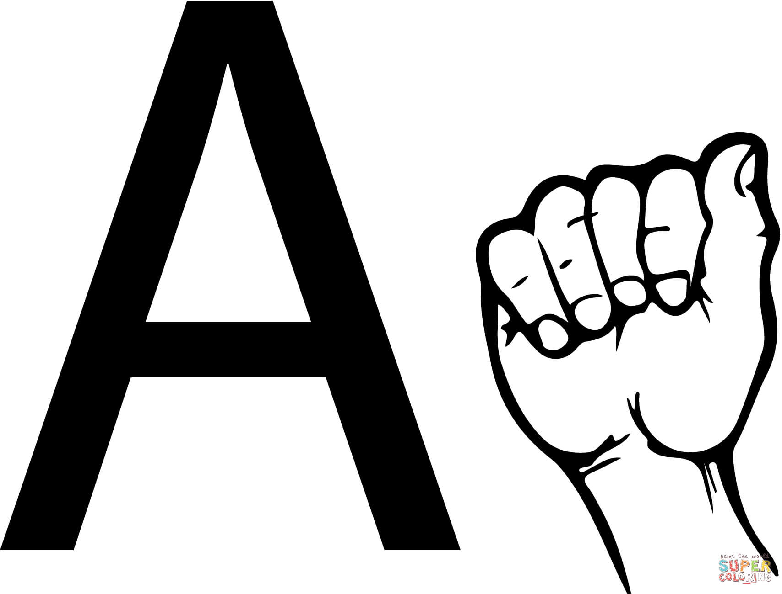
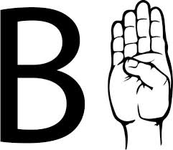
Code
if ( voltage1 < s1_0 && voltage2 > s2_1 && voltage3 > s3_1 && voltage4 > s4_1 && voltage5 > s5_1){ ble.println("A"); display.clearDisplay(); display.print("A"); }
if ( voltage1 > s1_0 && voltage1 < s1_1 && voltage2 < s2_0 & voltage3 < s3_0 && voltage4 < s4_0 && voltage5 < s5_0){ ble.println("B"); display.clearDisplay(); display.print("B"); }

Slide 8
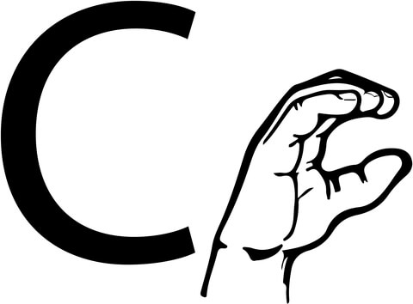
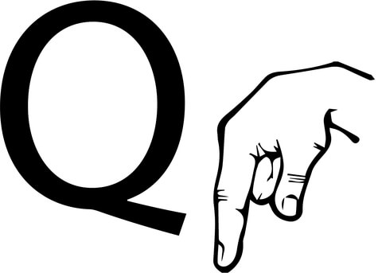
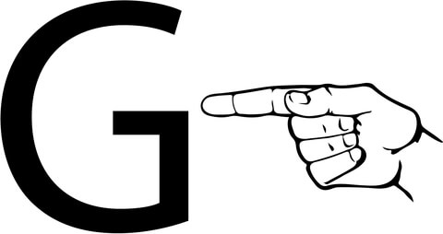
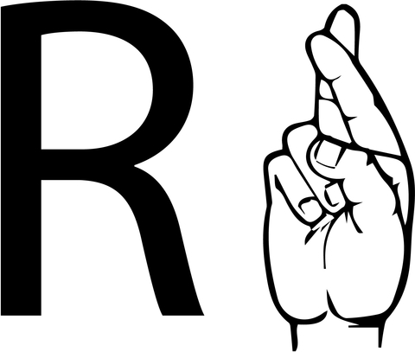
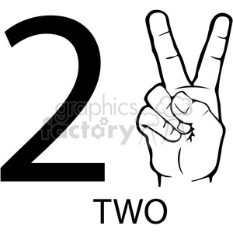
DRAWBACKS
It is difficult to reliably get the bend sensors between the two thresholds so it can be difficult to read the letter C
To minimize this problem only two sensors are used the thumb and the index finger
Some sign language letter are impossible to distinguish between 5 bend sensor like Q and G or R and 2
The limitation of the Hardware
Number of Analog Inputs and SDA SCL
Memory Size

Slide 9
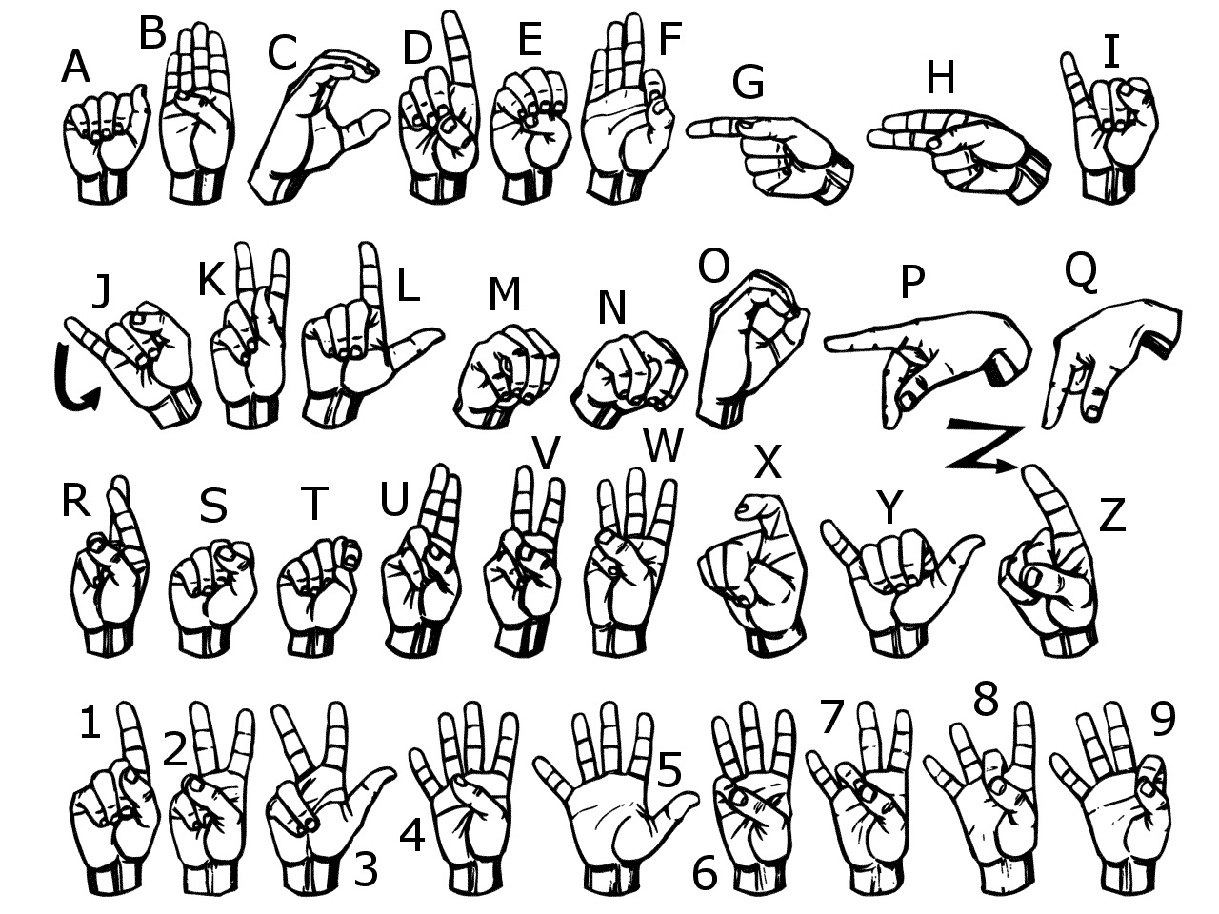

Slide 10
CONCLUSIONS
We were able to successfully build a smart glove that would convert convert sign language .
Our team hopes to aid the deaf people and enhance the interaction between deaf and non-deaf speakers.
As discussed before, there is a huge scope of improvement and we would work to make this device better by choosing a better microcontroller, employing more number of good quality sensors and make the device more compact, sturdy and wearable.

Slide 11
THANK YOU

Slide 12
QUESTIONS ??

